Slide 1
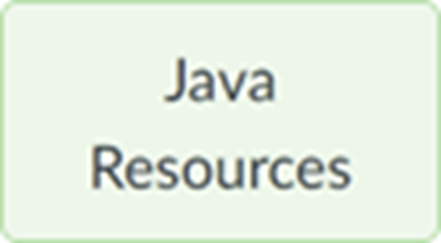
Section 02 (week of Sep 11): Advanced Java part 1
We'll start at 5:01 (Tuesday) and 7:16 (Wednesday) Eastern Time.
Pset 1 is due at start of the lecture 4 week (Sep 25) at 9am. See the Notes.
Your questions
Enumerations
Review: Switch Statement
“For Each” loops
Variable Length Arguments
Autoboxing
Scanner “hasNext*()” methods
Counting Recursive Calls
Zip file with this section’s slides and sample code is posted to course’s page

Slide 2
Enumerations
Define a restricted set of mnemonically-friendly values
Compiler ensures only legal values can be used.
Enumerations have instance methods
values() returns array of enumeration's members
ordinal() returns member’s underlying numeric value
name() returns member’s mnemonic "name"
Arguments can be enumeration values
When switch variables are enumeration values ...
cases don't include type's name (DaysOfWeek), just the case's mnemonic "name"
See EnumDemo.java

Slide 3
The switch Statement (traditional)
if ( switchVar == val₁) { ... } else if switchVar == val₂) { ... } ... else { ... }
switch( switchVar ) { case val₁: ... break; case val₂: ... break; ... default: ... }
See SwitchTraditionalCaseLabels.java, SwitchModernCaseLabels.java SwitchExpressionsTraditionalCaseLabels.java, SwitchExpressionsModernCaseLabels.java

Slide 4
The switch Statement (modern)
if ( switchVar == val₁) { ... } else if switchVar == val₂) { ... } ... else { ... }
switch( switchVar ) { case val₁ -> { ... } case val₂ -> { ... } default ₂ -> { ... } }
See SwitchTraditionalCaseLabels.java, SwitchModernCaseLabels.java SwitchExpressionsTraditionalCaseLabels.java, SwitchExpressionsModernCaseLabels.java

Slide 5
“For Each” loops
Iterates through a collection like an array or an ArrayList
Friendly syntax when value's array index unneeded
foo( 1.1, 2.2 ); ... void foo( double ... list ) { for ( double value : list ) { System.out.print( value ); } }
See ForEachDemo.java

Slide 6
Variable Length Arguments
The variable args are received in an array
The variable args must be at end of arg list
Can have at most one variable section of arg list
foo( 1.1, 2.2 ); ... void foo( double ... list ) { for ( int i=0; i<list.length; i++ ) { System.out.print( list[i] ); } }
See VarNumOfArgsDemo.java

Slide 7
Autoboxing
Automatic conversion from a primitive value to its wrapper class
Unboxing: Automatic conversion from a wrapper class to its primitive value
See AutoboxingDemo.java

Slide 8
Scanner “hasNext*()” methods
Introduced in 10A
hasNextInt() is true if buffer’s next unconsumed token can be converted to an int
Overloaded for each primitive data type.
hasNext() is true if the buffer has an unconsumed token regardless of type
See ScannerHasNextDemo.java

Slide 9
Counting Recursive Calls
Requires non-final class-level variable in a program class.
That’s an EXCEPTION to the general PROHIBITION against that!!
See CountingRecursiveCalls.java

